Slide 1
Cardboard 2 Leather Nicaragua Distribution Trip 2015
Oriole Advocates
Bob and Shirley Harden, Mike Licea, Richard Young

Slide 2
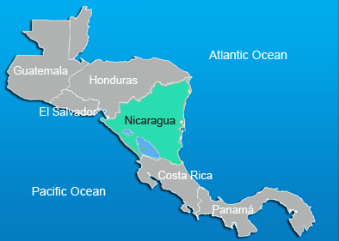
Nicaragua Distribution Trip 2015
6,000,000 population
Per capita $5,069
Coffee and bovine meats
50,000 Sq. Miles

Slide 3
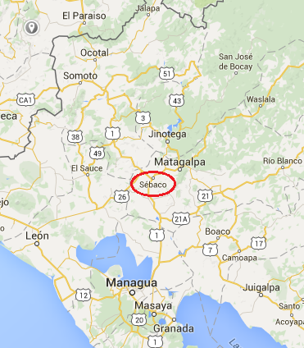
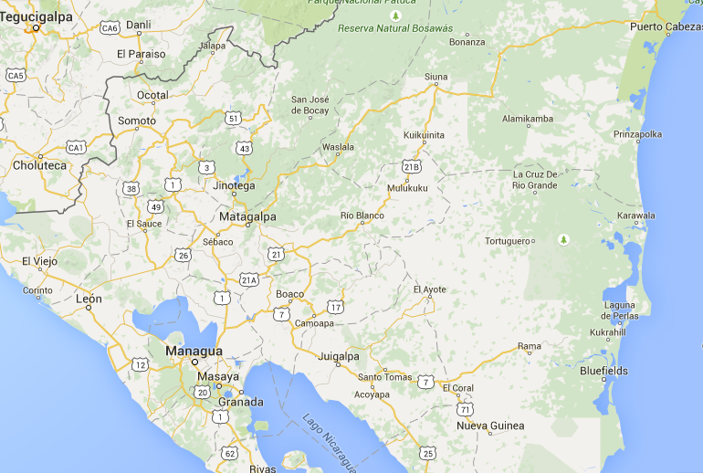
Nicaragua Distribution Trip 2015

Slide 4
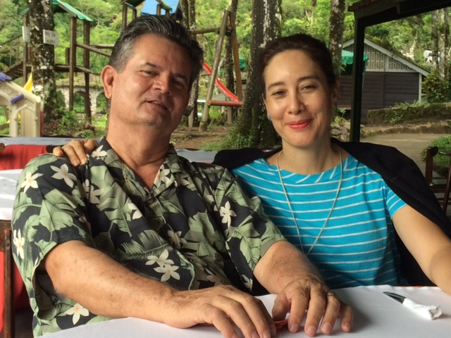
Nicaragua Distribution Trip 2015
Alex and Johanna Torres
Live in Sebaco
Well connected
Former Nicaraguan National Baseball Team Manager
Drafted by the O’s Twice
Able to provide food, lodging and transportation

Slide 5
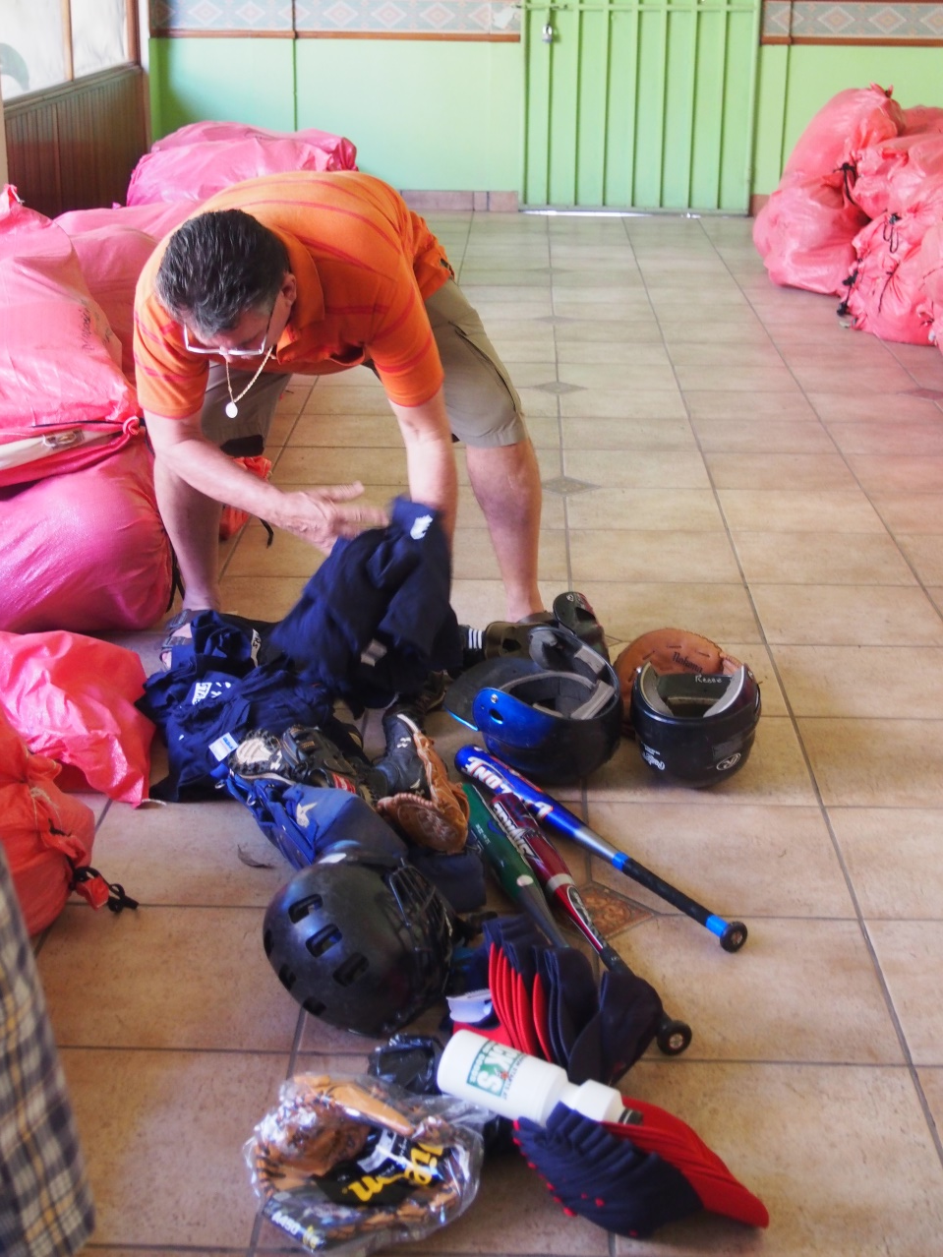
Nicaragua Distribution Trip 2015

Slide 6
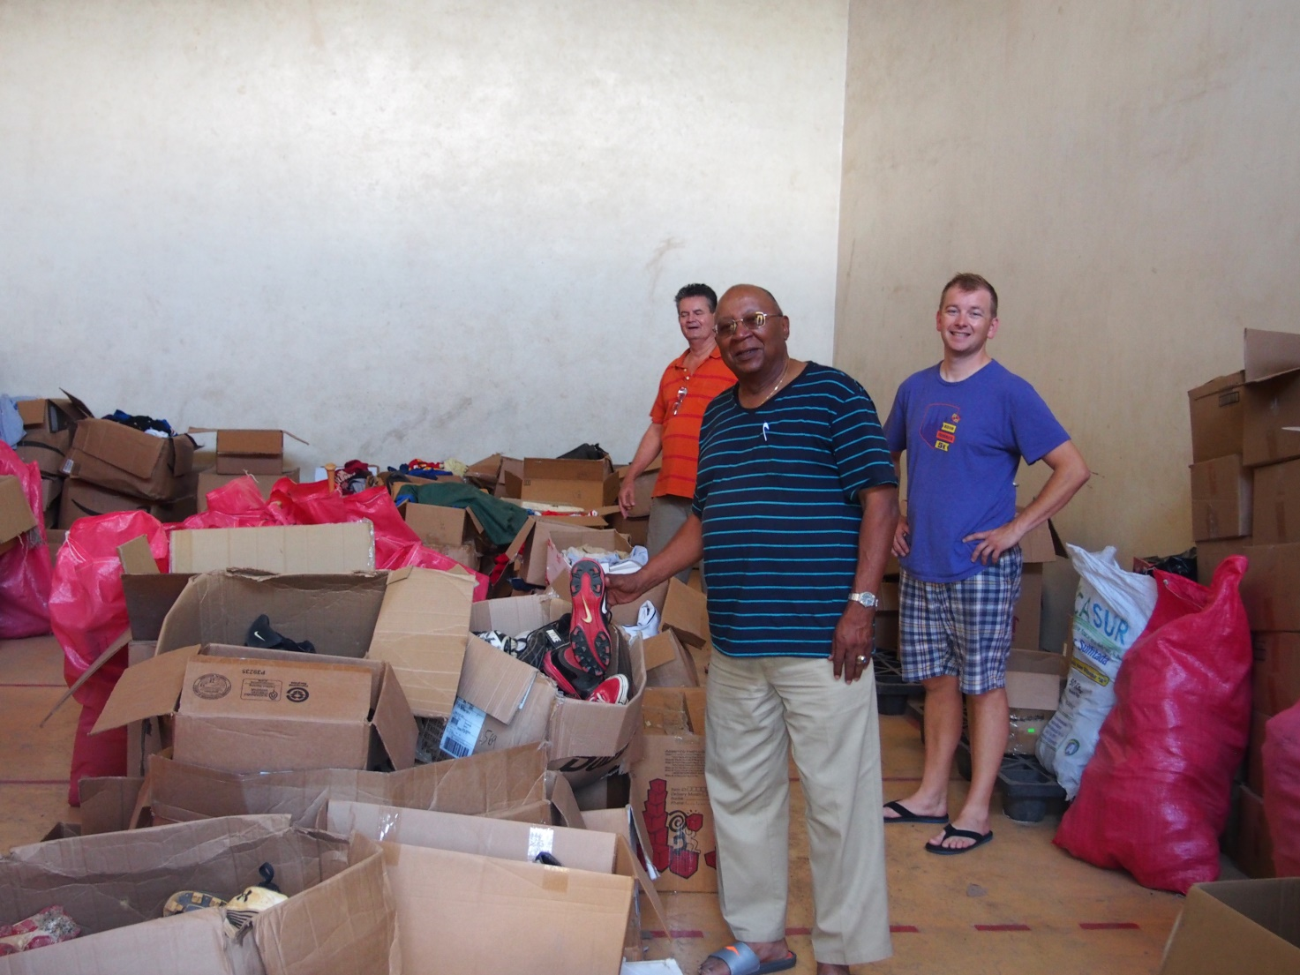
Nicaragua Distribution Trip 2015

Slide 7
Nicaragua Distribution Trip 2015

Slide 8
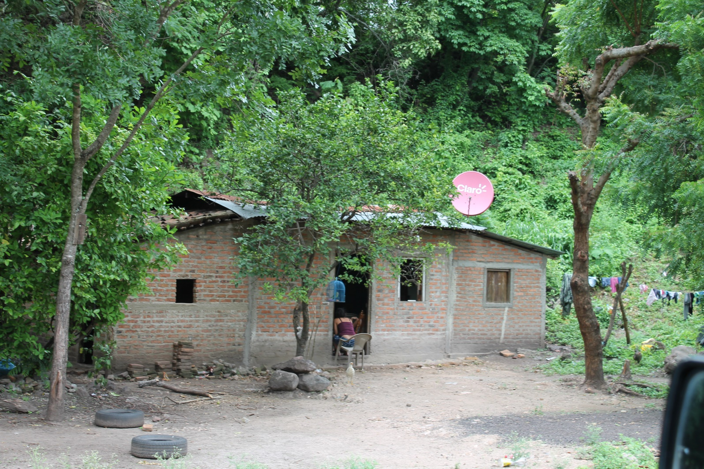
Nicaragua Distribution Trip 2015

Slide 9
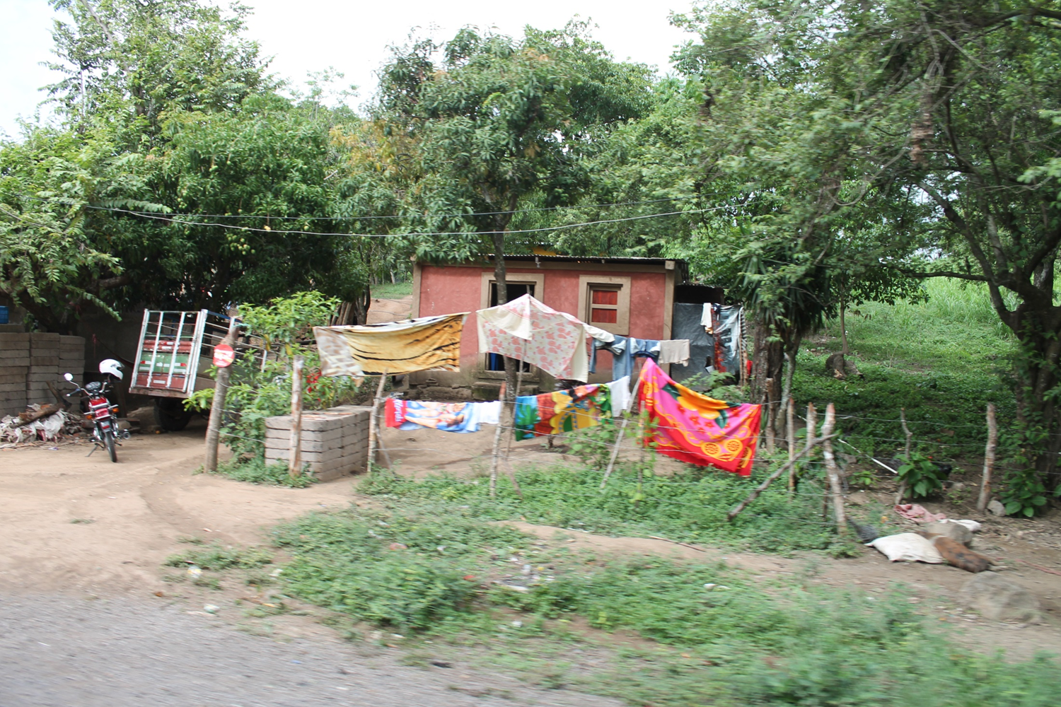
Nicaragua Distribution Trip 2015

Slide 10
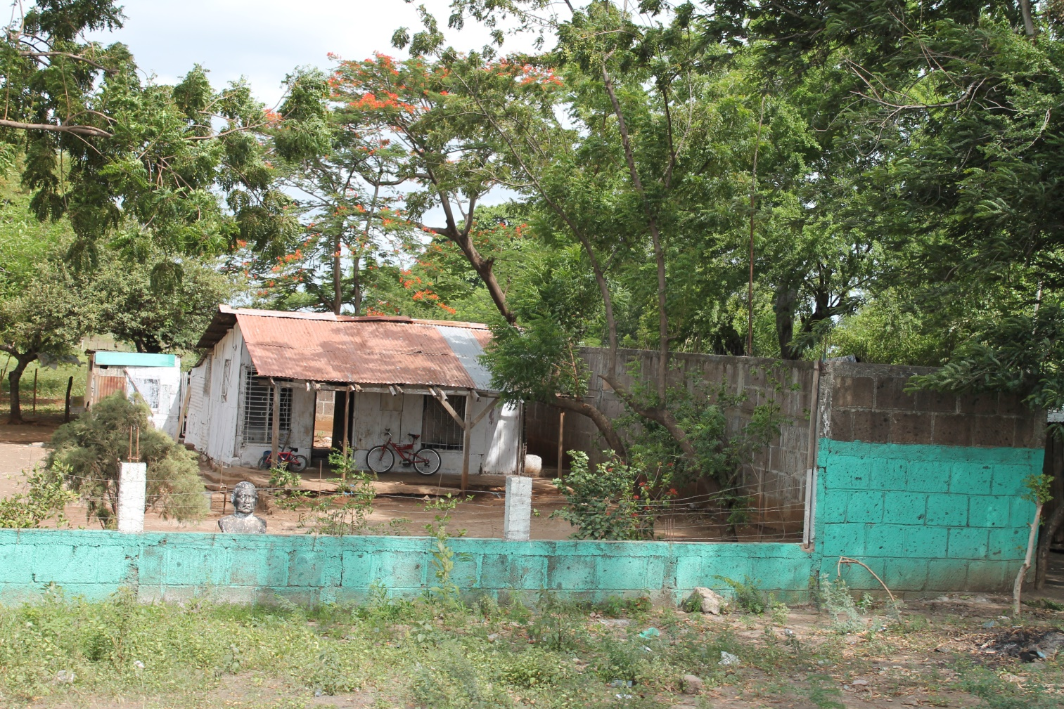
Nicaragua Distribution Trip 2015

Slide 11
Nicaragua Distribution Trip 2015

Slide 12
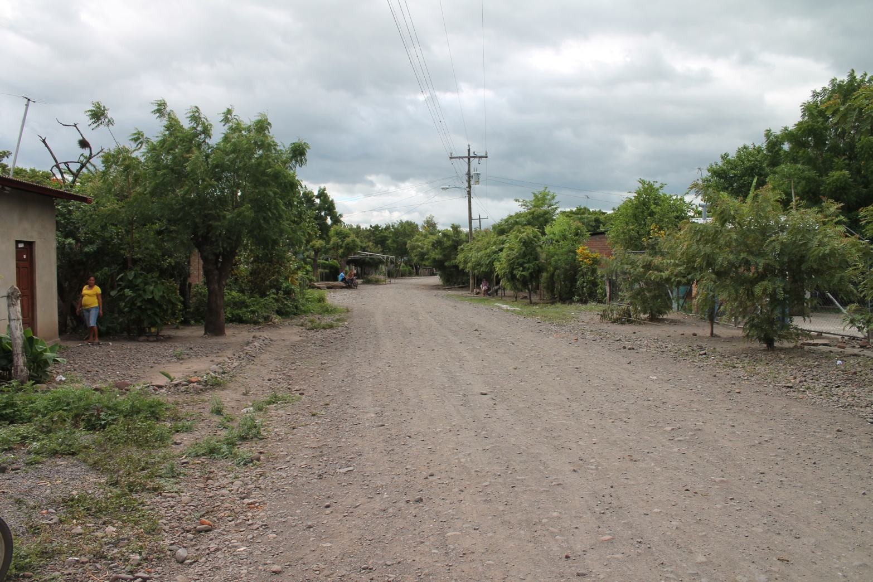
Nicaragua Distribution Trip 2015

Slide 13
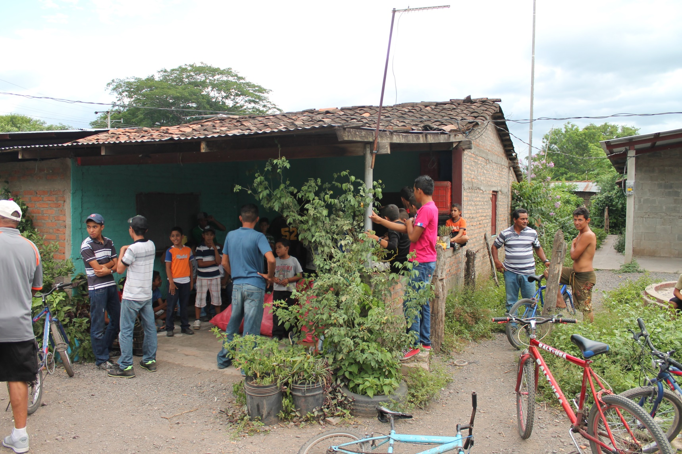
Nicaragua Distribution Trip 2015

Slide 14
Nicaragua Distribution Trip 2015

Slide 15
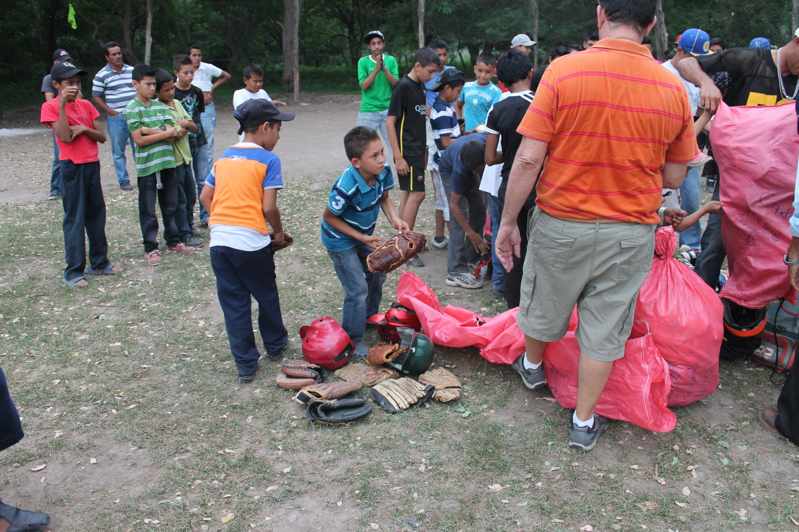
Nicaragua Distribution Trip 2015

Slide 16
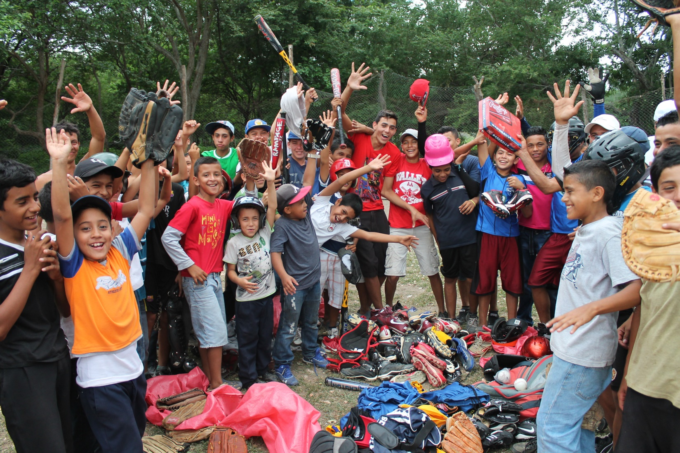
Nicaragua Distribution Trip 2015

Slide 17
Nicaragua Distribution Trip 2015

Slide 18
Nicaragua Distribution Trip 2015

Slide 19
Nicaragua Distribution Trip 2015

Slide 20
Nicaragua Distribution Trip 2015

Slide 21
Nicaragua Distribution Trip 2015

Slide 22
Nicaragua Distribution Trip 2015

Slide 23
Nicaragua Distribution Trip 2015

Slide 24
Nicaragua Distribution Trip 2015

Slide 25
Nicaragua Distribution Trip 2015

Slide 26
Nicaragua Distribution Trip 2015

Slide 27
Nicaragua Distribution Trip 2015

Slide 28
Nicaragua Distribution Trip 2015

Slide 29
Nicaragua Distribution Trip 2015

Slide 30
Nicaragua Distribution Trip 2015

Slide 31
Nicaragua Distribution Trip 2015

Slide 32
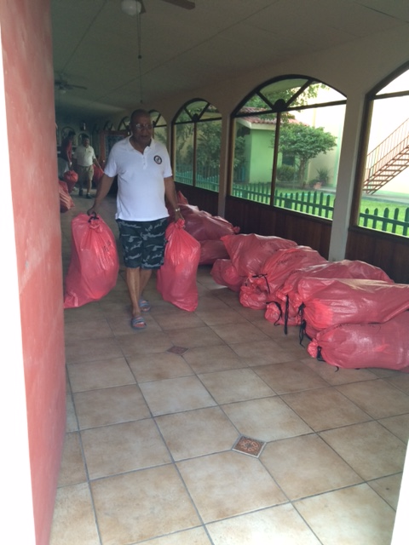
Nicaragua Distribution Trip 2015

Slide 33
Nicaragua Distribution Trip 2015

Slide 34
Nicaragua Distribution Trip 2015

Slide 35
Nicaragua Distribution Trip 2015

Slide 36
Nicaragua Distribution Trip 2015

Slide 37
Nicaragua Distribution Trip 2015

Slide 38
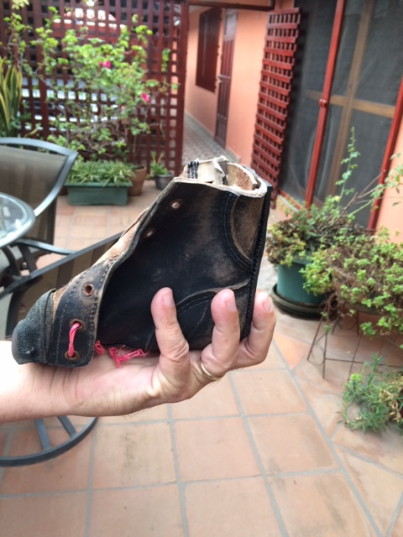
Nicaragua Distribution Trip 2015

Slide 39
Nicaragua Distribution Trip 2015

Slide 40
Nicaragua Distribution Trip 2015

Slide 41
Nicaragua Distribution Trip 2015

Slide 42
Nicaragua Distribution Trip 2015

Slide 43
Nicaragua Distribution Trip 2015

Slide 44
Nicaragua Distribution Trip 2015

Slide 45
Nicaragua Distribution Trip 2015

Slide 46
Nicaragua Distribution Trip 2015

Slide 47
Nicaragua Distribution Trip 2015

Slide 48
Nicaragua Distribution Trip 2015

Slide 49
Nicaragua Distribution Trip 2015

Slide 50
Nicaragua Distribution Trip 2015

Slide 51
Nicaragua Distribution Trip 2015

Slide 52
Nicaragua Distribution Trip 2015

Slide 53
Nicaragua Distribution Trip 2015

Slide 54
Nicaragua Distribution Trip 2015

Slide 55
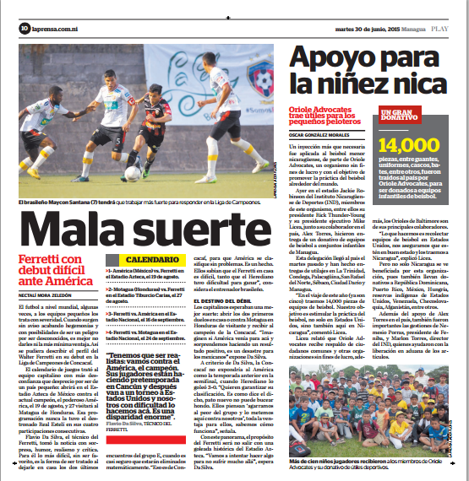
Nicaragua Distribution Trip 2015

Slide 56
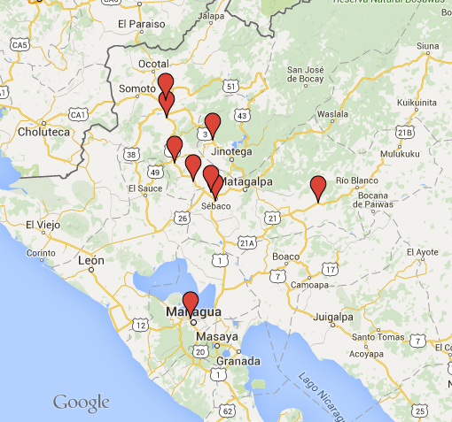
Nicaragua Distribution Trip 2015
6 days
10 hours spent packing items
9 drop off locations
120 teams
2088 children impacted
10,000 baseball equipment items distributed

Slide 57
Cardboard 2 Leather Nicaragua Distribution Trip 2015
Oriole Advocates
Bob and Shirley Harden, Mike Licea, Richard Young

